Slide 1
From Word Embeddings To Document Distances （2015ICML）
2019级学硕王维川

Slide 2
Project:MI Music Copywriting
Task:generate music copywriting
Method:TextRand(first)
Word Mover’s Distance(second&ultimate)
TextRand:An extraction automatic summarization
PageRank(Idea from)
Extract key words about music and generate music copywriting
Probolem:Rely on corpus and hard to assess
Decision:Change the corpus and Choose WMD to generate music copywriting

Slide 3
Introduction
Abstract:
can be cast as an instance of the Earth Mover’s Distance
no hyperparameters & straight-forward to implement&Unsupervised
Introduction:
Document representation methods:BOW/(TF/IDF)
Latent Semantic Indexing Latent Dirichlet Allocation
Word2Vec( semantic relationships )
Optimization:
Well-studied EMD transportation problem
lower bounds

Slide 4
Related Word
Document representation: score for each (word,document) pair
score for document and document(LDA)
corpus-based statistics
transform subtopics via the EMD
Counting Grid
EMD method:
applications in computer vision
Word2Vec Embedding :
novel word-embedding procedure & semantic relationships

Slide 5
Word Mover’s Distance
Parameter setting:
word2vec embedding matrix
word embedding
word weight
document nBOW vector
Word Euclidean distance
sparse flow matrix

Slide 6
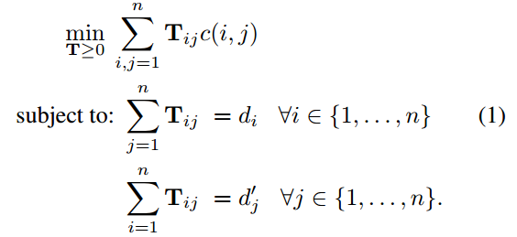
Word Mover’s Distance
Algorithm:

Slide 7
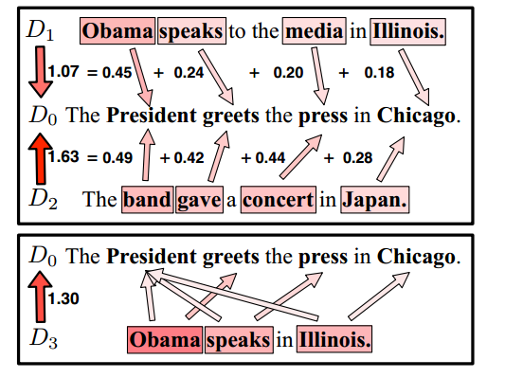
Word Mover’s Distance
Visualization :

Slide 8
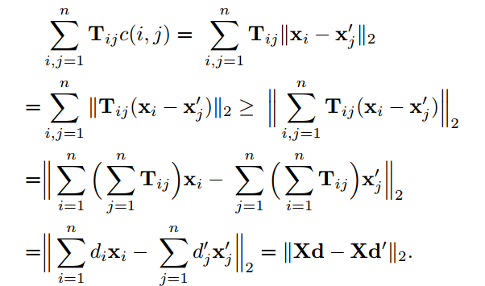
Word Mover’s Distance
Fast Distance Computation :
Word centroid distance:

Slide 9
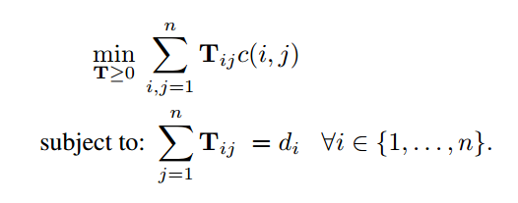
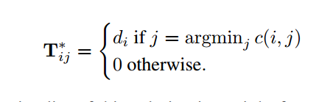
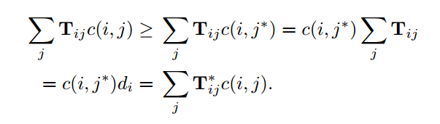
Word Mover’s Distance
Relaxed word moving distance :

Slide 10
Word Mover’s Distance
Prefetch and prune :
find the k nearest neighbors of a query document :
①sort all documents by their WCD distance
②compute the exact WMD distance to the first k of these documents
③firstly compute RWCD distance if exceed kth closest document prune,else compute WMD distance.
traversal is limited to m < n documents prefetch and prune m= k returnithe k nearest neighbors of the WCD distance m= n provably non-neighbors are pruned

Slide 11
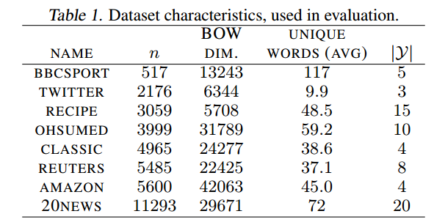
Result
Dataset:

Slide 12
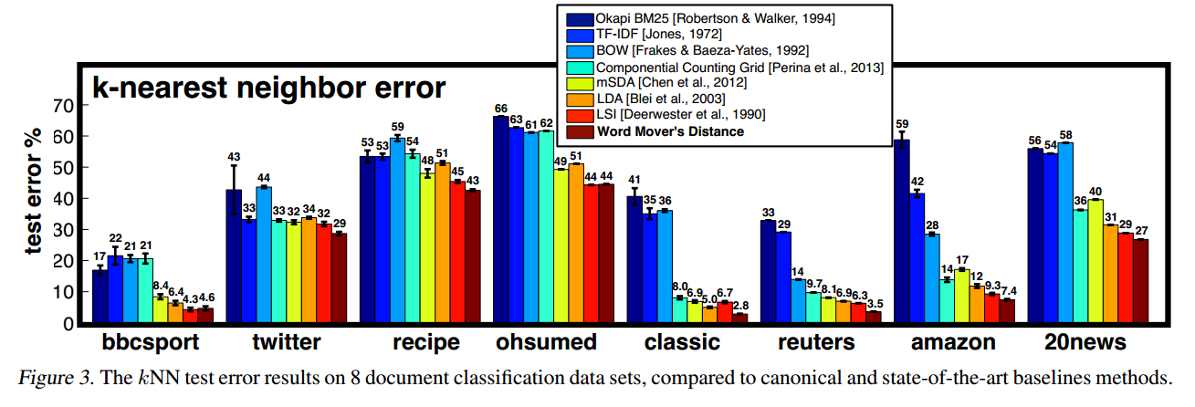
Result
Compare against 7 document representation baselines(KNN )

Slide 13
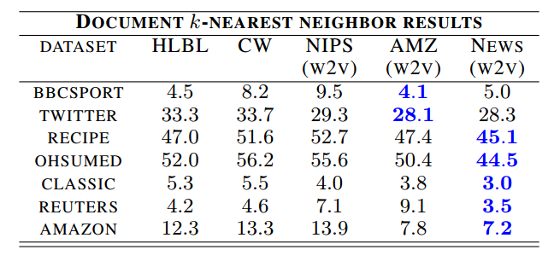
Result
Word embeddings:

Slide 14
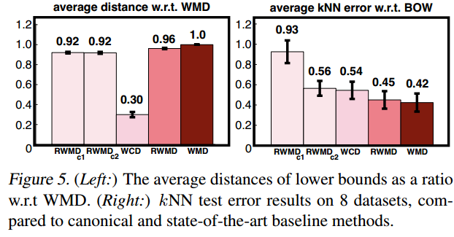
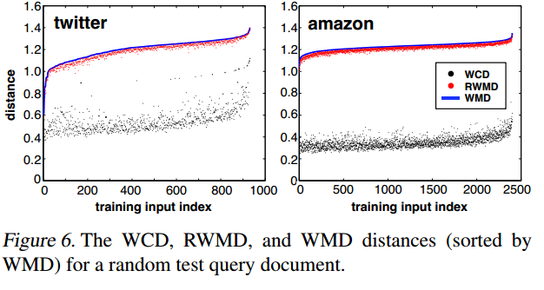
Result
Lower Bounds and Pruning :

Slide 15
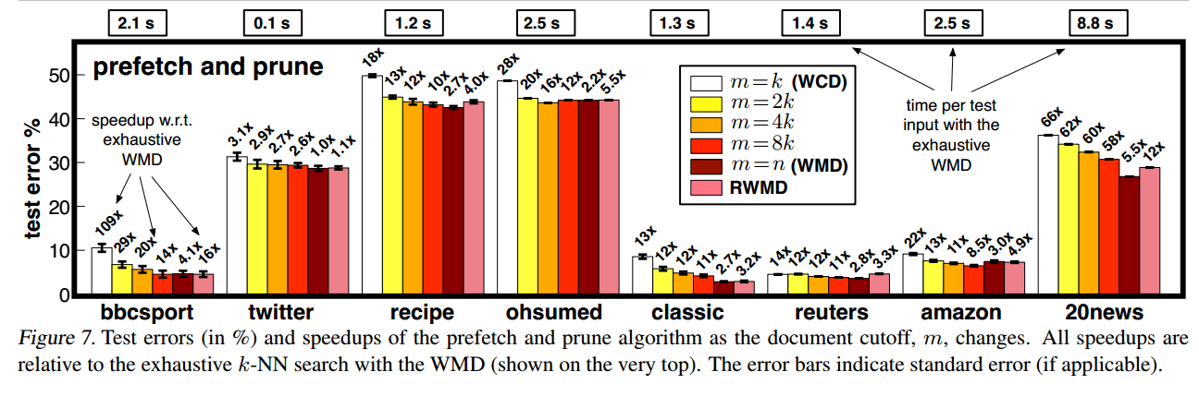
Result

Slide 16
Discussion & Conclusion &Inspiration
D&C:
utilize the high quality of the word2vec embedding
the scale of data sets
Document distances can be dissected into sparse distances between words
Inspiration:
Add penalty word movements in specific structure
Help to categorization
Other fields analogy or Inspiration

